Slide 1
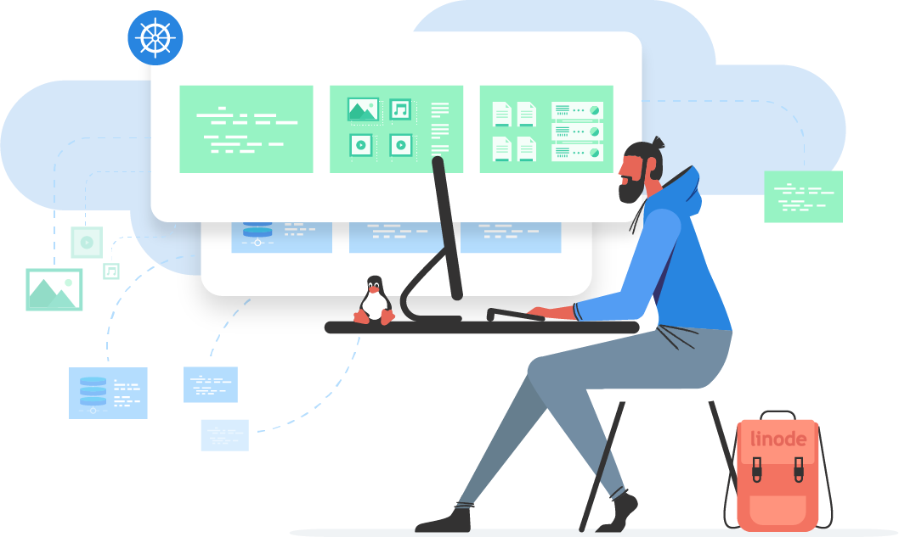
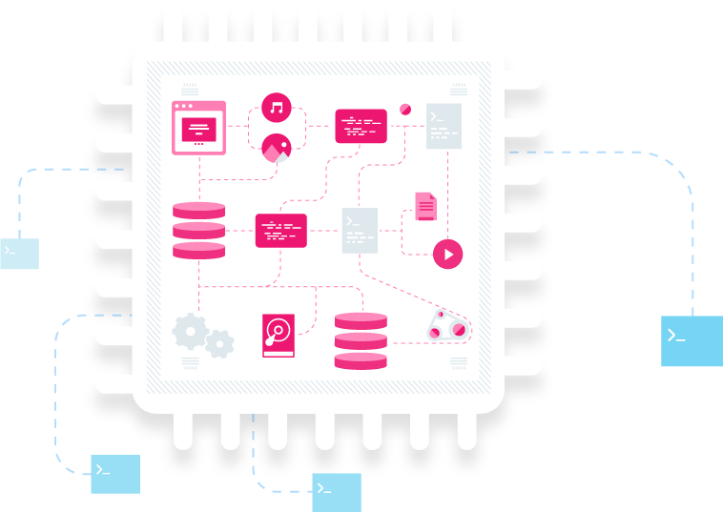
COMPLETE CLOUD COMPUTING & FULL-STACK DEVELOPMENT MASTERCLASS

Slide 2
INTRODUCTION TO CLOUD COMPUTING

Slide 3
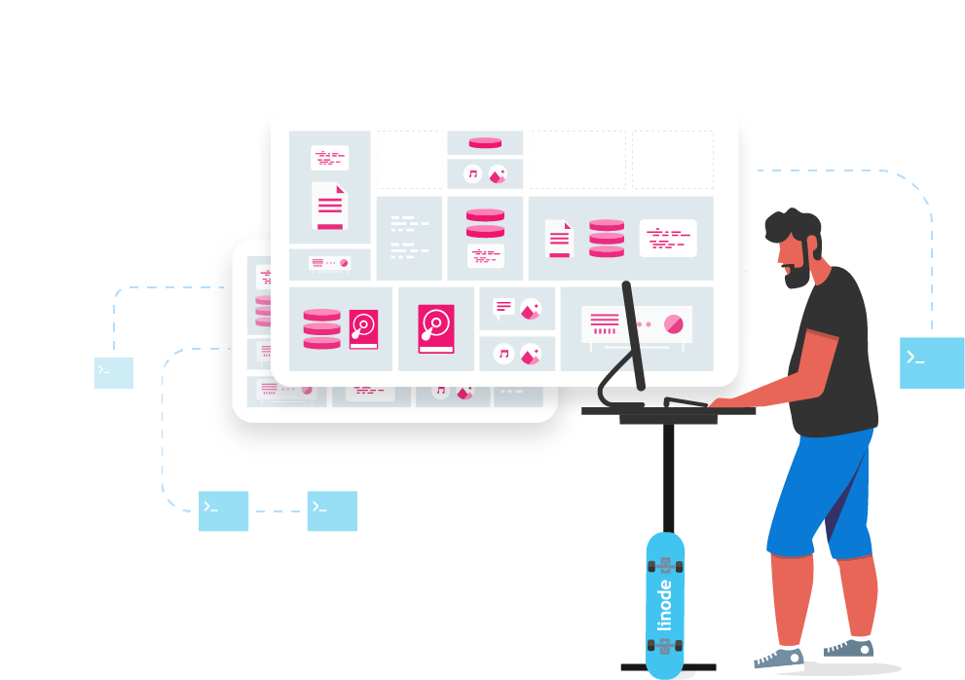
Intro to Cloud Computing
Cloud computing allows developers and system administrators to provision computing resources over the internet.
Delivers on-demand computing services, through a pay-as-you-go model.
Computing resources can easily be scaled up and down, depending on resource requirements.

Slide 4
Intro to Cloud Computing
The ability to provision resources on-demand is achieved through “virtualization”.
Virtualization: “The process of running a virtual instance of a computer system in a layer abstracted from the actual hardware” (Opensource.com).

Slide 5
Intro to Cloud Computing
Advancements in virtualization is the reason for an influx in migration from on-premises data centers to the cloud.
System administrators can deploy virtual computing instances at the click of a button.

Slide 6
Intro to Cloud Computing
Virtual Instance: An emulated version of a computer system that operates through a hardware abstraction layer (HAL).
The HAL provides an operating system the ability to interact with the underlying hardware devices, through programs known as “hypervisors”.

Slide 7
Intro to Cloud Computing
A virtual instance can operate as a completely self contained computing environment on top of another system.
Through “abstraction”, virtual instances are instantaneously able to provision any number of resources from the hardware layer.
This includes CPU, memory, storage, and network resources.
Cloud computing is perfect for projects of any size.

Slide 8
BENEFITS OF CLOUD COMPUTING

Slide 9
Benefits of Cloud Computing
Many benefits of cloud computing when compared with traditional physical infrastructure.
Core advantages can be defined by five categories:
Greater cost efficiency
Improved agility, faster time to market
Greater scalability and elasticity
Improved reliability and business continuity
Improved performance and security

Slide 10
Benefits of Cloud Computing
Greater cost efficiency
Provisioning resources on demand reduces overhead expenses when compared with traditional physical data centers.
Before the cloud, organizations would maintain on-premises or private remote data centers.
All servers and computing capacity would be physically stored and maintained by the organization’s system administrators.

Slide 11
Benefits of Cloud Computing
Greater cost efficiency
Administrators would struggle with estimating computing resource requirements.
Under or overestimating requirements would result in higher costs.
Ongoing expenses of maintaining on-premises infrastructure would become problematic.
Especially for businesses with high spikes in traffic.

Slide 12
Benefits of Cloud Computing
Greater cost efficiency
Cloud computing eliminates these issues.
Third party service providers are responsible for the maintenance and up-keep of data centers.
On-demand pay-as-you-go pricing models help minimize costs and improve efficiency.

Slide 13
Benefits of Cloud Computing
Improved agility, faster time to market
Deploy highly customized virtual instances in minutes.
Perfect for both testing and production environments.
Perfect for applications of any size or complexity.

Slide 14
Benefits of Cloud Computing
Improved agility, faster time to market
Much more efficient to setup than traditional on-premises infrastructure.
Perfect for deploying test systems that require a high amount of resource for short durations of time.

Slide 15
Benefits of Cloud Computing
Improved agility, faster time to market
A virtual instance can be deployed instantly using various operating systems, disk configurations, network resources, and Computational power.
Easily transition between testing and production environments using IP Swaps.

Slide 16
Benefits of Cloud Computing
Greater scalability and elasticity
Cloud providers operate data centers that are spread across the globe.
Linode operates 11 low latency, global data centers around the world.
Applications can be deployed in close proximity to end users.
This translates into rapid, low latency data access.

Slide 17
Benefits of Cloud Computing
Greater scalability and elasticity
Achieving this with traditional on-premises infrastructure would be challenging for most organizations.
This characteristic of cloud computing allows organizations to scale workloads infinitely without sacrificing performance.

Slide 18
Benefits of Cloud Computing
Improved reliability and business continuity
Global networks that power cloud data centers help ensure network redundancy.
If one node fails, multiple communication links keep the infrastructure operational.

Slide 19
Benefits of Cloud Computing
Improved reliability and business continuity
Allows for cost efficient storage of data across multiple geographic regions to minimize data loss and downtime.
Most cloud providers offer both on-demand and scheduled back-up services.

Slide 20
Benefits of Cloud Computing
Improved performance and security
Cloud service providers focus entirely on maintaining and improving their cloud infrastructure.
This results in data centers with the highest performing compute, storage, and network resources.
Dedicated teams are tasked with monitoring the network.

Slide 21
Benefits of Cloud Computing
Improved performance and security
Lax security protocols have resulted in massive data breaches.
In May 2017, Equifax reported a major breach from failing to patch a basic security vulnerability.
Financial records of 140 million Americans were compromised (Haselton).

Slide 22
Benefits of Cloud Computing
Improved performance and security
Cloud service providers have made security improvements over on-premises data centers.
McAfee reports that 52% of companies will experience improved security when using cloud services over traditional on-premises data centers.

Slide 23
Benefits of Cloud Computing
Improved performance and security
Security burden is shared between customer and cloud vendor.
Cloud provider is responsible for the security of the cloud.
This includes hardware and software components of its global infrastructure.

Slide 24
Benefits of Cloud Computing
Improved performance and security
Cloud administrator is responsible for security related to OS, apps, firewalls, and customer data.
Sharing of responsibilities is referred to as the “shared responsibility model”.

Slide 25
CLOUD COMPUTING SERVICE MODELS

Slide 26
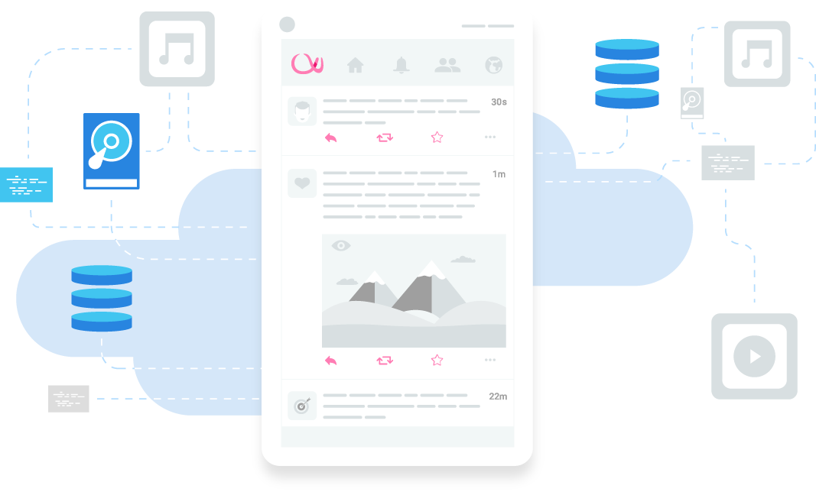
Cloud Computing Service Models
Three cloud service models:
Infrastructure as a Service (IaaS)
Platform as a Service (PaaS)
Software as a Service (SaaS)

Slide 27
Cloud Computing Service Models
With traditional infrastructure, the organization is responsible for all IT assets
This includes: System hardware, software, applications, development tools, and administration.
Organization would purchase resources, install them, and manage them within their own data center.

Slide 28
Cloud Computing Service Models
With cloud computing, the cloud service provides customers with console access to deploy resources through a web-based platform.
Cloud provider bills customer (cloud tenant) a specified amount based on resource consumption, on a pay-as-you-go basis.

Slide 29
Cloud Computing Service Models
Resources employed will depend on an organizations needs.
Provisioned assets can be grouped into one or more of three service models.
This includes: IaaS, PaaS, SaaS.

Slide 30
INFRASTRUCTURE AS A SERVICE (IaaS)

Slide 31
Cloud Computing Service Models
Infrastructure as a Service (IaaS)
One of the most commonly used cloud computing service models.
Helps eliminate the need to house costly on-premises data centers.
Offers highly scalable on-demand computing infrastructure.
Operates on a subscription model.

Slide 32
Cloud Computing Service Models
Infrastructure as a Service (IaaS)
Customer can provision an infinite amount of computing resources.
All resources managed by a third party.
Cloud provider hosts, manages, and maintains all hardware and computing resources throughout it’s globally distributed data centers.

Slide 33
Cloud Computing Service Models
Infrastructure as a Service (IaaS)
Linode is an example of an IaaS platform.
Through a web-based interface, Linode customers can deploy highly scalable compute, storage, and network resources.
IaaS examples: Amazon Web Services (AWS), Microsoft Azure, Google Cloud.

Slide 34
Cloud Computing Service Models
Infrastructure as a Service (IaaS)
IaaS customers can provision compute resources by deploying virtual instances which are hosted on shared or dedicated physical resources.
Compute resources extracted from shared physical resources are managed through virtualization.

Slide 35
Cloud Computing Service Models
Infrastructure as a Service (IaaS)
IaaS allows for efficient deployment of compute, storage, and network resources.
Most cloud providers offer web-based graphic dashboards or API access.
Compute resources can be provisioned rapidly through a few clicks.

Slide 36
Cloud Computing Service Models
IaaS Key Benefits
Offers the ability to easily provision and scale resources on-demand.
Eliminates high up-front and overhead costs.
Eliminates the risk of network and resource outages.
Improves service availability and minimizes downtime.
Lower latency, higher network performance.

Slide 37
Cloud Computing Service Models
IaaS Key Benefits
Cloud providers offer superior on-site security.
This includes data encryption, network monitoring, and security.
Cloud providers focus on their physical architecture, resulting in the latest hardware and firmware.

Slide 38
Cloud Computing Service Models
IaaS Key Benefits
Cloud providers offer superior on-site security.
This includes data encryption, network monitoring, and security.
Cloud providers focus on their physical architecture, resulting in the latest hardware and firmware.

Slide 39
Cloud Computing Service Models
IaaS Use Cases
E-Commerce
Software Development + Testing
Artificial Intelligence (AI) & Internet of Things (IoT)
Disaster Recovery and Data Storage

Slide 40
PLATFORM AS A SERVICE (PaaS)

Slide 41
Cloud Computing Service Models
Platform as a Service (PaaS)
Cloud provider provisions a larger portion of the IT workload than under the IaaS model.
PaaS platforms maintain software, including OS, middleware, runtime, development tools, virtualization, and necessary frameworks.
Also includes services related to software and hardware security, upgrades, data storage, and backups.

Slide 42
Cloud Computing Service Models
Platform as a Service (PaaS)
All resources provisioned under PaaS are done so over the internet, using a GUI.
PaaS service providers are often used by development and operations (DevOps) teams.

Slide 43
Cloud Computing Service Models
Platform as a Service (PaaS)
Great for collaboration on every aspect of the development lifecycle. Including: coding, integration, testing, delivery, deployment, and feedback (IBM).
PaaS models provide efficient mechanisms to build and deploy applications while maintaining flexibility and control over the deployment environment.

Slide 44
Cloud Computing Service Models
Platform as a Service (PaaS)
There are several well known PaaS solutions including: Google App Engine, AWS Elastic Beanstalk, Openshift, Heroku, Oracle Cloud Platform, and Cloudways.

Slide 45
Cloud Computing Service Models
PaaS Key Benefits
Flexibility and Scalability
Speed to Market
Managed and Low-risk

Slide 46
Cloud Computing Service Models
PaaS Use Cases
DevOps
API Development and Management
Data Management and Analytics
Internet of Things (IoT)

Slide 47
SOFTWARE AS A SERVICE (SaaS)

Slide 48
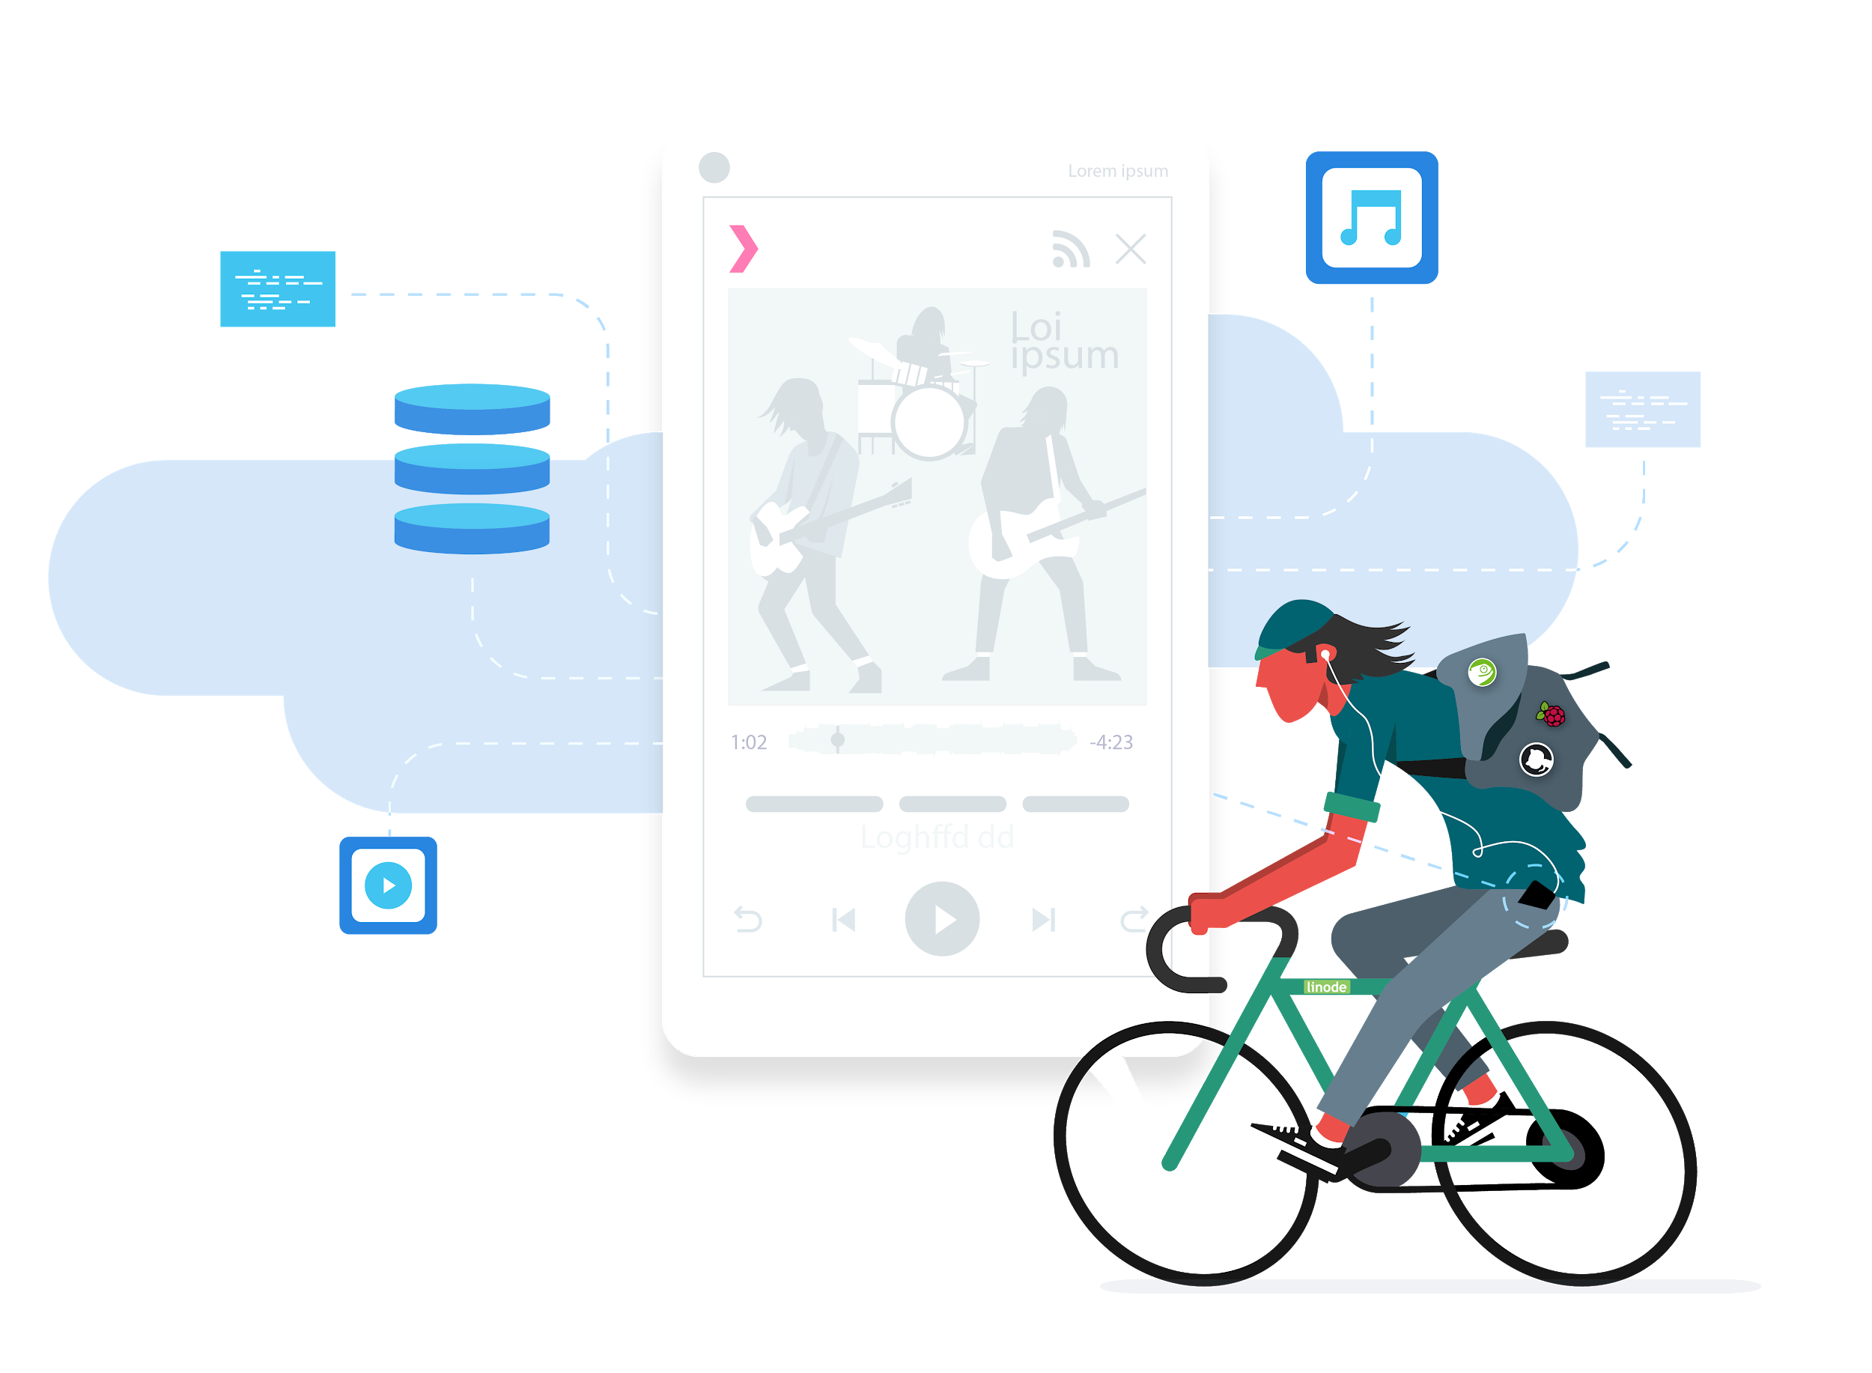
Cloud Computing Service Models
Software as a Service (SaaS)
SaaS products are ready-to-use, cloud-hosted applications that are generally subscription based.
Applications are delivered through web browsers, desktop clients, or mobile apps.
Clients are not involved in decisions relevant to infrastructure, data storage, or middleware.

Slide 49
Cloud Computing Service Models
Software as a Service (SaaS)
System upgrades, patches, and security are fully managed by the vendor.
Chances are you have used a SaaS product.
SaaS applications are licensed by you or your organization.
Applications are hosted and maintained on the cloud service vendors data centers.

Slide 50
Cloud Computing Service Models
Software as a Service (SaaS)
SaaS products are user friendly and designed with the customer in mind.
Examples: Google Workspace, Microsoft Office 365, Salesforce, MailChimp, Hubspot, Slack, and DocuSign.

Slide 51
IaaS vs PaaS vs SaaS

Slide 52
Cloud Computing Service Models
On-Site | IaaS | PaaS | SaaS
Application | Application | Application | Application
Data | Data | Data | Data
Runtime | Runtime | Runtime | Runtime
Middleware | Middleware | Middleware | Middleware
O/S | O/S | O/S | O/S
Virtualization | Virtualization | Virtualization | Virtualization
Servers | Servers | Servers | Servers
Storage | Storage | Storage | Storage
Networking | Networking | Networking | Networking
You Manage
Service Provider Manages

Slide 53
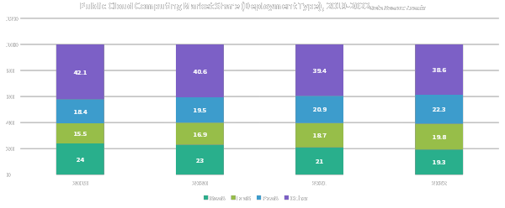
Cloud Computing Service Models

Slide 54
LINODE ACCOUNT SETUP

Slide 55
EXPLORING THE ADMIN DASHBOARD

Slide 56
ENABLING TFA ON LINODE

Slide 57

Enabling TFA on Linode
Account security is essential.
Unauthorized access can result in the theft of confidential information.
Resources within the account can be permanently deleted.

Slide 58

Enabling TFA on Linode
Accounts can be secured using TFA.
TFA requires two forms of authentication to login.
This includes a secure password, along with an authorized security token generated by a TFA app.
The TFA app is installed on a secondary device, such as you smartphone.

Slide 59
Enabling TFA on Linode
You have likely already used TFA.
Services such as Gmail and Facebook encourage users to implement TFA to keep accounts secure.

Slide 60
Enabling TFA on Linode
KNOWLEDGE
(Something you know)
TFA
TFA
MFA
POSSESSION
(Something you have)
INHERENCE
(Something you are)
TFA

Slide 61
Enabling TFA on Linode
We will work with knowledge and possession.
We already setup an account password.
Never share passwords.
Password = Knowledge in TFA
Possession = Google Authenticator App

Slide 62
DEPLOYING AN INSTANCE ON LINODE

Slide 63
Deploying an Instance on Linode
Dedicated CPU Plan:
Use when peak speed and efficiency are required.
No other instances can run processes on the same cores.
CI/CD toolchains and build servers
CPU-intensive game servers, like Minecraft or Team Fortress
Audio and video transcoding and streaming
Big data and data analysis
Scientific computing
Machine learning

Slide 64
Deploying an Instance on Linode
Shared CPU Plan:
Broad use cases, from personal projects to enterprise apps.
Websites and web applications
Code repositories
Game servers
Database servers
Virtual private networks (VPNs)
Container clusters

Slide 65
Deploying an Instance on Linode
High Memory:
Used for workloads that require higher RAM allocations and relatively fewer CPUs and less storage.
Typically used for in-memory caches and in-memory databases like Memcached, and Redis.
Typically used for storing web application analytics data. For example User Session Logs, and frequently requested pages.

Slide 66
Deploying an Instance on Linode
GPU:
Extremely high performance.
Only GPU plans provide access to NVIDIA Quadro RTX 5000 GPU cards.
Designed to process large blocks of data in parallel.
Best for workloads requiring thousands of simultaneous threads.
Can perform computations and process large amounts of data in parallel.
Great for specialized applications such as ML, AI, and Video transcoding, and Big Data.

Slide 67
EXPLORING THE LINODE INSTANCE DASHBOARD

Slide 68
REMOTE SERVER ADMIN VIA SSH

Slide 69
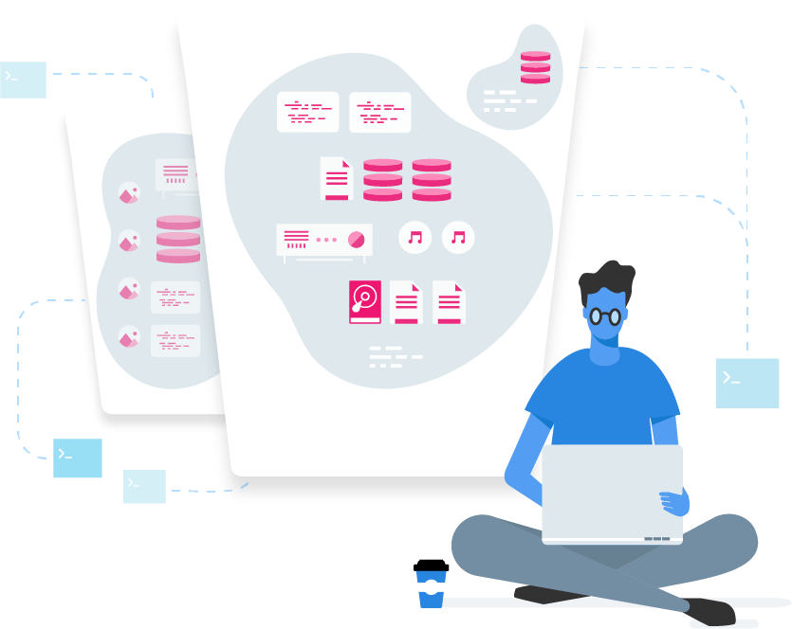
Remote Server Admin via SSH
Why connect remotely?
Updating the operating system.
Installing, updating, or removing software packages and service applications.
Creating, Deleting, or Modifying system files and directories.
Monitoring system performance and other analytics.
Installing and configuring security patches and firewalls.

Slide 70
Remote Server Admin via SSH
An instance is located in a remote data center.
A connection is required to execute commands to an instance.
We will connect and perform actions via the command line.
With a local computer, you hook up a monitor and have access to a graphical desktop environment.

Slide 71
PASSWORD VS SSH KEY AUTHENTICATION

Slide 72

Remote Server Admin via SSH
Password vs SSH Keys
It’s important to connect to an instance securely.
On instance deployment we configured a “root” password for server authentication.
Plain text passwords are not secure enough.

Slide 73
Remote Server Admin via SSH
Password vs SSH Key Authentication
Passwords are susceptible to brute-force attacks.
This is where an attacker attempts to login to an instance by automatically trying different combinations of characters until the correct combination is found.

Slide 74
Remote Server Admin via SSH
Password vs SSH Key Authentication
SSH Key authentication helps protect against password related security vulnerabilities.
This method of authentication can be performed through login utilities included as part of the OpenSSH suite of software tools.
OpenSSH project: https://www.openssh.com
IBM defines OpenSSH as “an open source version of the SSH protocol suite of network connectivity tools”.

Slide 75
Remote Server Admin via SSH
Password vs SSH Key Authentication
The OpenSSH suite contains tools for remote server operations. This Includes:
The OpenSSH remote login client (ssh)
The OpenSSH Daemon (sshd)
OpenSSH secure file copy (scp)
OpenSSH secure file transfer (sftp)

Slide 76
Remote Server Admin via SSH
Password vs SSH Key Authentication
OpenSSH also includes a host of encrypted key management utilities including: ssh-add, ssh-keysign, ssh-keyscan, and ssh-keygen.
We will work with ssh-keygen to generate keys later on.
The SSH Client for secure remote connections is installed on most Linux distributions and macOS by default.

Slide 77
Remote Server Admin via SSH
Password vs SSH Key Authentication
Windows users can use PuTTY.
PuTTY supports SSH connections through a terminal emulator.
PuTTYgen can be used for generating key pairs on Windows.
The SSH protocol facilitates client-server connections over TCP.
The SSH Protocol is the most trusted, remote access open source network protocol used by system administrators.

Slide 78
Remote Server Admin via SSH
Password vs SSH Key Authentication
The manual for the latest OpenSSH release states: “the SSH2 protocol implemented in OpenSSH is standardized by the IETF”.
IETF: The Internet Engineering Task Force.

Slide 79
Remote Server Admin via SSH
Password vs SSH Key Authentication
The protocols architecture works on three layers including:
The Transport Layer
The User Authentication Layer
The Connection Layer

Slide 80
Remote Server Admin via SSH
SSH CLIENT
Requests Connection
SSH SERVER
Encrypted Message using Public Key
Decrypted Message using Private Key
Public Key
Private Key
Public Key
Connection Established

Slide 81
Remote Server Admin via SSH
Password vs SSH Key Authentication
The SSH client is an application stored on our local machine.
The client is used to initiate and negotiate a connection between the client and remote server.
During this process a key exchange takes place which results in an encrypted connection.

Slide 82
Remote Server Admin via SSH
Password vs SSH Key Authentication
The authentication layer utilizes the established connection and operates on top of the transport layer.
It is used to facilitate mechanisms for user authentication.
Two common forms of authentication include traditional password and SSH Key authentication.

Slide 83
Remote Server Admin via SSH
Password vs SSH Key Authentication
SSH key authentication has two important elements: A Private Key & Public Key.
A private key is an encoded stream of random bits that is contained within a key file and stored on the client computer.
The private key should be kept secret and never shared.

Slide 84
Remote Server Admin via SSH
Password vs SSH Key Authentication
The public key is another stream of bits that is derived from the private key.
We can generate a unique public key from a private key, but not vice versa.
The public key is stored on both the client and server

Slide 85
Remote Server Admin via SSH
Password vs SSH Key Authentication
The term “key pair” is derived from the connection between the private and public key.
A successful login operations occurs when the private key successfully decrypts the public key.
The connection layer runs on top of the authentication layer and manages the SSH session.

Slide 86
Remote Server Admin via SSH
Password vs SSH Key Authentication
Important use cases for SSH:
Secure remote access to resources on an instance.
Secure file transfers between computers over a network.
Remote execution of commands.
Delivery of software patches and updates.

Slide 87
SSH KEY AUTHENTICATION [WINDOWS]

Slide 88
SSH KEY AUTHENTICATION [LINUX & MAC]

Slide 89
CONNECTING WITH LISH

Slide 90
ADDING SSH PUBLIC KEYS TO LINODE

Slide 91
INTRODUCTION TO LINUX

Slide 92

Introduction to Linux
Linux is a kernel.
The Linux kernel acts as the “core interface between a computer’s hardware and its processes” (Linux).
We will be working extensively with Linux distributions when configuring our instances.

Slide 93
Introduction to Linux
A “distribution” is the Linux equivalent of an operating system.
Earlier we deployed our instance using the Linux Ubuntu 20.04 LTS distro.
Ubuntu is a popular distro for running websites and web applications.

Slide 94
Introduction to Linux
Each distribution offers a different “flavor” of Linux.
Popular distributions include: MX Linux, Manjaro, Debian, Ubuntu, Fedora, CentOS.
A regularly updated list of Linux distributions ranked by popularity can be found here: https://distrowatch.com

Slide 95
Introduction to Linux
Linux is a great choice for several reasons.
Linux is a powerful, open-source OS.
Founded in the mid 1990s.
Linux is one of the most widely used operating systems in the world.

Slide 96
Introduction to Linux
Android is based on a modified version of the Linux kernel.
Linux powers of 37% of all websites on the internet including all of the world’s top 500 supercomputers and world’s stock exchanges (Linux) .
Windows powers 20.05% of all websites (w3techs).

Slide 97
Introduction to Linux
 | Windows | Linux
Manufacturer/Developer | Microsoft | Linus Torvalds and Linux Community
Open Source | Proprietary. | Yes, fully open source under GNU General Public License
Cost | License cost per user | Freely downloadable and distributable.
Primary Web Server Technology | Microsoft IIS | Apache, NGINX
Scripting Languages | VBScript, ASP.NET | Perl, PHP, Python, Ruby
Databases | MSSQL, MS Access | MySQL, MariaDB, PostgreSQL
Security | Prone to security vulnerabilities and user errors. Often targeted by malicious agents such as hackers, viruses, malware etc. | More stable and secure. Threats are monitored by a world-wide community of developers and patched very quickly.

Slide 98
Introduction to Linux
Let’s go over important terms relevant to Linux.
A complete index is available at: https://www.linux.com/what-is-linux/

Slide 99
Introduction to Linux
Bootloader: A software that handles the boot processes of the Linux system.

Slide 100
Introduction to Linux
Kernel:
The main core of Linux.
Handles communication between the computers hardware and processes to ensure resources are managed efficiently.
Five main functions:
Memory Management, Process Management, Device Drivers, System Calls, Security.

Slide 101
Introduction to Linux
Kernel:
Memory management keeps tabs on how much memory is used by active applications.
Process management manages processes that are allowed to use the CPU and the duration of time.
Device drivers act as an intermediary and interpreter between system processes and hardware.

Slide 102
Introduction to Linux
Desktop Environment:
Most desktop focused Linux distributions are equipped with a desktop environment.
This offers a graphical way for users to interact with the operating system.
Examples: GNOME, Xfce, Cinnamon, MATE, and Plasma.

Slide 103
Introduction to Linux
Desktop Environment:
Comes equipped with a number of commonly used default applications.
This includes: Web browsers, file managers, configuration tools, and games.
Users are free to mix and match different applications as they please.

Slide 104
Introduction to Linux
Applications:
Linux offers a large number of software applications that can be installed on the system.
Applications are managed by a centralized software center, similar to the Apple App store.
Example: The Ubuntu Software Center offers a searchable catalog of thousands of apps for the Ubuntu Linux distro.

Slide 105
THE LINUX FILESYSTEM

Slide 106
The Linux Filesystem
It’s important to understand the Linux directory structure.
Linux systems organize files using a hierarchical structure.
Directories refer to file folders that can contain other directories, or files.
The Linux filesystem can be thought of as a “tree”.

Slide 107
The Linux Filesystem
Each subsequent directory being a child directory of its parent.
A single forward slash (“/”) designates the beginning of the tree or file hierarchy.
A path name is used to reference elements of the file tree.

Slide 108
The Linux Filesystem
Absolute or full reference path names start with “/”.
This character identifies the filesystem root which contains all other directories and files on the Linux system.
The filesystem root houses a number of sub directories.
Each child directory of the filesystem in an absolute path reference is separated by a forward slash (“/”).

Slide 109
The Linux Filesystem
Examples of file and directory structures on Ubuntu:
/usr/bin/test This is an absolute file path that points to an executable file.
/usr/bin/ This is another absolute file path, pointing to the directory “bin”.

Slide 110
The Linux Filesystem
bin/test This file path will point to the test executable file located in the bin directory, if the active directory is located in the /usr/ parent directory. For example: /usr/local/

Slide 111
The Linux Filesystem
../bin/test This file path will point to the executable file “test” located in the bin directory, as long as the current directory is located in the /usr/ parent directory. For example: /usr/local/

Slide 112
The Linux Filesystem
/
bin/
dev/
etc/
usr/
home/
lib/
sbin/
tmp/
var/
bin/
man/
lib/
local/
share/
log/
lock/
tmp/

Slide 113
The Linux Filesystem
/ - The systems root directory. It contains all system files and folders. Also contains system files required for the O/S boot sequence.
/root – The root users home directory. Also known as a “superuser” since root can perform any action on the system. NOT to be confused with the system root directory “/”.

Slide 114
The Linux Filesystem
/boot – Contains the files needed to launch the system.
/home – Contains files and folders that belong to individual (non-root) users. It’s safer to use non-root users for system administration when possible.
/var – Contains important variable data such as logs, databases, and websites. Example: “/var/www/html” for web files.

Slide 115
The Linux Filesystem
/etc – Contains global configuration files and additional executable files required to boot the system. Also stores some log files.

Slide 116
The Linux Filesystem
That’s all you need to know for now regarding directories!
Check out this valuable resource for more info on the Linux file system hierarchy (FHS Standard): https://refspecs.linuxfoundation.org/FHS_3.0/fhs/index.html

Slide 117
LINUX MAINTENANCE COMMANDS

Slide 118
LINUX DIRECTORY COMMANDS [P.1]

Slide 119
LINUX DIRECTORY COMMANDS [P.2]

Slide 120
UBUNTU BASIC SERVER CONFIGURATION

Slide 121
INTRODUCTION TO USER ACCOUNTS

Slide 122

Introduction to User Accounts
Until now we have been using the root user account for server administration.
The root user account is the default administrative account that is created when a Linux distribution is installed on an instance.
The root account has the highest level of admin privileges.

Slide 123
Introduction to User Accounts
The root account can make destructive changes to the system (intentionally or unintentionally).
Examples of actions the root account can perform:
Deleting/executing essential system files, applications and dependencies.
Creating, deleting or modifying other non-root accounts.
Modifying permissions and access levels for just about any directory, file, or application on the system.

Slide 124
Introduction to User Accounts
Root account exploitations can be complex, but know that they are possible.
Example: a security vulnerability in a single application can grant an attacker root privileges to the system.
Damage can also be done by accident by executing the wrong command.

Slide 125
Introduction to User Accounts
Ubuntu allows for multiple user accounts with different levels of permissions.
It’s important to specify the user privileges based on the purpose of the account.
User groups can be created for complex server configurations.

Slide 126
Introduction to User Accounts
Users added to groups will inherit the privileges assigned to the group.
A group with administrative privileges is known as the “sudo” group, or “wheel” group.
The applicable term depends on the Linux distribution.

Slide 127
Introduction to User Accounts
Any member of the sudo group can execute administrative commands using the sudo, or su command.
“sudo” stands for “substitute user do”.
The “sudo” command grants partial admin privileges.
The “su” command grants the same privileges as the root account.

Slide 128
Introduction to User Accounts
Admin privileges assigned to a non-root account are also referred to as “superuser” privileges.
Stay tuned for a hands-on guide to user accounts and groups.

Slide 129
CREATING A NON-ROOT ACCOUNT

Slide 130
SECURING A NEW USER ACCOUNT

Slide 131
SECURING A NEW USER ACCOUNT

Slide 132
DISABLING ROOT USER ACCESS & PASSWORD AUTHENTICATION

Slide 133
INTRODUCTION TO WEB SERVERS

Slide 134
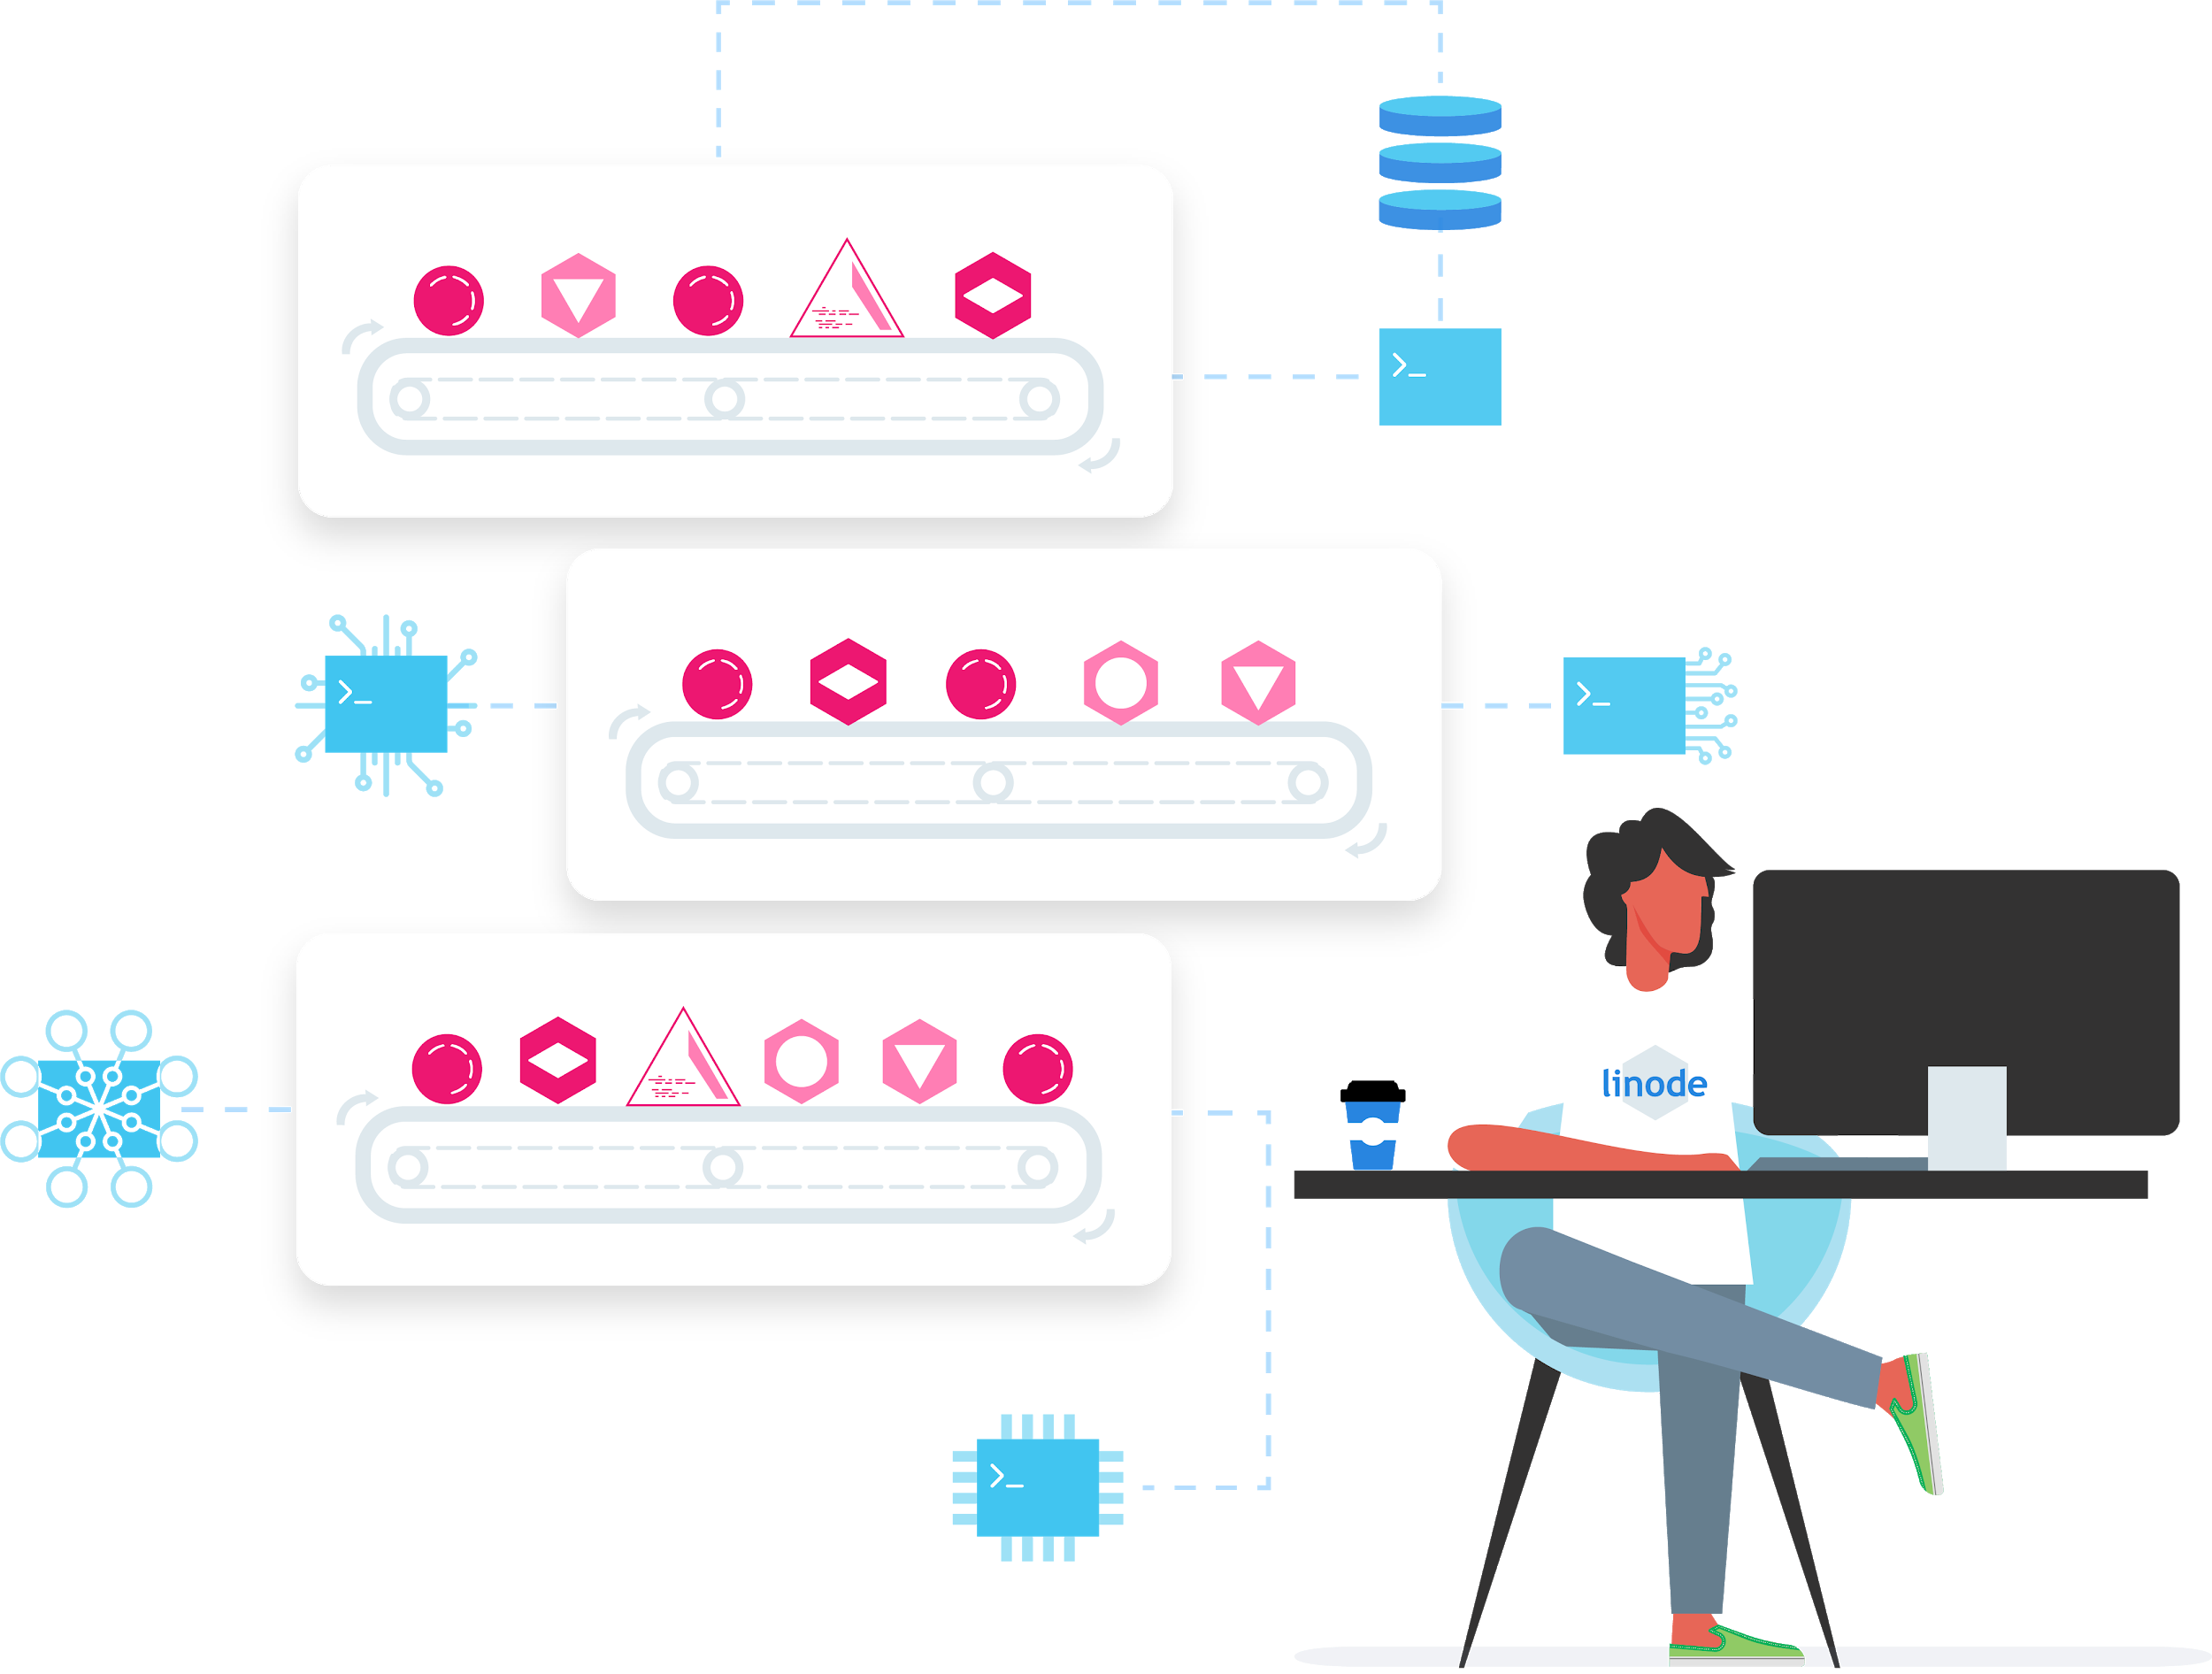
Introduction to Web Servers
It’s important to understand the role of web servers in the development process.
We will explore the role of web servers in delivering web content.
A web server is composed of both hardware and software.

Slide 135
Introduction to Web Servers
Web server hardware refers to the physical or virtual computer which stores the web server software, files, and components that comprise the website or application.
This includes static HTML documents, text files, images, video content, and dynamic scripts.

Slide 136
Introduction to Web Servers
The web server is connected to the internet and facilitates the physical interchange of data with other devices connected to the web.
The web server software installed on the physical or virtual machine controls the accessibility of files on the server by web users.

Slide 137
Introduction to Web Servers
Web users use clients in order to connect with web servers and view web content.
The most common client used for this purpose is a web browser.
HTTP is the communication protocol used in order for a web browser to communicate with a web server.

Slide 138
Introduction to Web Servers
HTTP is responsible for encoding and transporting information (data packets) between a web server and the client used to access it.
“HTTP is the primary protocol for transmission of information across the internet” (NGINX).

Slide 139
Introduction to Web Servers
HTTP uses a request-response mechanism.
A client makes a request for content and the web server issues a response.
The response includes information about the status of the request, along with the content requested (if successful).

Slide 140
Introduction to Web Servers
The information contained within a request is exchanged between the client and server in the form of hypertext documents.
Hypertext is a structured text format that can be manipulated using HTML (Hypertext Markup Language).

Slide 141
Introduction to Web Servers
Clients can request different types of content from web servers using HTTP requests along with HTML documents.
Examples: text, images, video, and application data.

Slide 142
Introduction to Web Servers
Files
HTTP Server
HTTP Request
HTTP Response
Web Server
Web Browser

Slide 143
Introduction to Web Servers
Communication rules between client and server:
Clients make HTTP requests to servers, while servers respond to client requests.
A URL must be specified when a client makes an HTTP request.
When an HTTP server receives a request, it checks whether a file at the specified URL exists.
If the file exists the web server sends back the file contents, or a “404” error if not found.
Every HTTP request must be answered by the server, even if the request fails.

Slide 144
SELF-HOSTING VS. PROVIDER

Slide 145
Self-hosting vs. Provider
Self-hosting considerations are important.
Internet Speed:
Bandwidth Limitations.
When a website visitor requests a file from your server, the file is uploaded to their computer.
Most retail internet plans focus on high-speed downloads, but only marginal upload speed.

Slide 146
Self-hosting vs. Provider
Power Consumption/Failure:
Operating a computer system continuously can increase electricity consumption.
Most homes and small offices do not have a backup power generator.
Back-ups:
Application data is always changing.
Additional storage devices maybe needed for data backups.

Slide 147
Self-hosting vs. Provider
Dynamic vs. Static IP:
Most ISPs assign a dynamic IP to home and small office networks.
IP address changes at various intervals.
Static IPs are preferable for web servers.
Static IPs incur additional costs.
Configuring a server to work with dynamic IPs requires technical expertise.

Slide 148
Self-hosting vs. Provider
Security:
Personal/office computers contain private information.
A personal computer used as a web server allows inbound connections over a public network.
This can open up a number of security vulnerabilities that can be exploited.

Slide 149
Self-hosting vs. Provider
Scalability:
As resource needs expand, hardware must be scaled.
This incurs additional costs, increased power consumption, and other complexities.
Liability
Hosting files for others can be make you liable for security breaches and data theft.

Slide 150
WEB SERVER SOFTWARE (NGINX VS. APACHE)

Slide 151

Web Server Software (NGINX vs. Apache)
NGINX and Apache are the two web-server software solutions that currently dominate the market.
Combined they account for 65% of the market share (w3techs).
NGINX holds market dominance at 33.8%.
Apache accounts for 31.4% of the market share.
This course will focus on Apache and NGINX

Slide 152
 | Apache | NGINX
Creator | Robert McCool | Igor Sysoev
Founded | 1995 | 2002
Open Source | Yes | Yes
Managed by: | Apache Foundation | NGINX Inc.
Purpose: | Web Server | Web Server and Reverse Proxy
Architecture | Process Driven (Creates a new thread for each connection request) | Event Driven (Handles multiple requests within one thread)
Optimal Performance | Dynamic Content | Static Content, Reverse Proxy, Load Balancing, Mail Proxy, HTTP Caching
Dynamic Content | Processes it internally within the Server. Does not require any additional software modules. | Does not process dynamic content. Must pass dynamic content to an external processor for execution.
OS Support | Supports all major OS including Linux, macOS, and Windows | Recommended for Linux systems. Compatible with macOS. Compatible with Windows but with Limited performance.
Centralized | No, allows for per-directory configuration directives through .htaccess files. | Yes. Does not allow any per-directory configuration directives.
Modules | Dynamically loadable module systems. | Modules are not dynamically loadable.
Support | Large and supporting community with mailing list, forums, etc. Extensive documentation from first and third party developers. | Newer technology with less documentation. Existing documentation may be limited to Russian language.

Slide 153
Web Server Software (NGINX vs. Apache)
Back end
(php, perl, python etc.)
Apache
Client
Front End
(NGINX)
NGINX
Static Content
(html, js, css, images, etc.)

Slide 154
INTRODUCTION TO DATABASES

Slide 155

INTRO TO DATABASES
As a full-stack developer or cloud administrator you will likely work with database software.
Apache is an open source HTTP server designed to serve web content.
Most dynamic web applications interact with databases to deliver a customized user experience.
Content on social media sites are custom tailored based on your browsing habits and site interactions.

Slide 156
INTRO TO DATABASES
Use profile information and other actions performed on social sites are stored in a database.
Examples: messages, likes, image posts, etc.
The volume of information stored in some databases is enormous.
Facebook had close to three billion users worldwide as of 2021 (Statista).
This includes 2.41 billion monthly active users (Hubspot).
Facebook generates 4+ petabytes of data per day (Osman).

Slide 157
INTRO TO DATABASES
Most of this data is stored in a network of databases distributed around the world.
Concepts relevant to data storage and retrieval are universally applicable to applications of all sizes.

Slide 158
INTRO TO DATABASES
“A database is an organized collection of structured information, or data, typically stored electronically in a computer system. A database is usually controlled by a database management system (DBMS). Together, the data and the DBMS, along with the applications that are associated with them, are referred to as a database system, often shortened to just ‘database’”. – Oracle

Slide 159
INTRO TO DATABASES
The DBMS allows applications and users to retrieve, update, and manage how information in the database is organized and optimized.
The DBMS offers the ability to perform admin operations such as monitoring, tuning, backups, and recovery (Oracle).
There are several varieties of DBMSes.
Each DBMS has different pros and cons depending on the use case.

Slide 160
INTRO TO DATABASES
This course will focus on relational (SQL) and non-relational (NoSQL) databases.

Slide 161
SQL VS. NOSQL DATABASES

Slide 162
SQL vs. NoSQL Databases
SQL Databases support the “Structured Query Language” (SQL).
SQL is used for manipulating data in a relational database.
The software used to manage, store, query, and retrieve data from a relational database is called a “Relational Database Management System” (RDBMS).
The relational database is the simplest to understand (think MS Excel).

Slide 163
SQL vs. NoSQL Databases
Excel lends itself well to the principles of how a relational database works.
Excel is composed of a collection of connected data points situated within rows and columns (a spreadsheet).
A single spreadsheet mirrors the function of a single “flat-file” database, not a relational one.
The relational database can be thought of as “a combination of the Master spreadsheet table and all of its Slave tables or spreadsheets” (Sartain).

Slide 164
SQL vs. NoSQL Databases
The “relational” aspect of a relational database is born from the relationships that can be derived from stored items of information across different tables.
Relationship categories: Master, Slave, Associated, Parent, and Child.

Slide 165
SQL vs. NoSQL Databases
Table: users
user_id | first_name | Last_name | dob | address
182374 | John | Smith | 01-15-1980 | 10 Hill Dr.
182375 | Ashley | Allen | 02-12-1975 | 11 Bell Ct.
182376 | Bob | Williams | 06-01-1982 | 15 Summer Dr.
msg_id | Message | date | sender | receiver
192383487 | Thanks for dinner! | 01-01-2022 | 182376 | 182374
Relationship Type: one-to-many

Slide 166
SQL vs. NoSQL Databases
Database relationship types:
One-to-many
One-to-one
Many-to-many
The relational database has been the industry standard model of data management, since its inception by IBM researcher E.F. Codd in the 1970’s (Anderson).

Slide 167
SQL vs. NoSQL Databases
Now let’s explore NoSQL databases.
NoSQL (“Not only SQL”) rose in the mid-2000s.
NoSQL has witnessed enthusiasm among developers for large data sets.

Slide 168
SQL vs. NoSQL Databases
Four categories of NoSQL databases:
Key-value database
Document database
Wide-column stores
Graph database
Used for web & mobile apps, analytics, and complex inventory/catalog management.

Slide 169
SQL vs. NoSQL Databases
NoSQL document databases store information in the JSON file format.
JSON is compact and readable for both humans and computers.
JSON is an acronym for “JavaScript Object Notation”.
JSON uses JavaScript to represent data in an organized, textual format.
JSON documents can include key value pairs or attributes, embedded JSON objects, and arrays.

Slide 170
SQL vs. NoSQL Databases
{
"id": 1,
"name": "John Doe",
"age": 25,
"interests": {
"movies": [
"Batman"
],
"sports": [
"Baseball"
]
}
}

Slide 171
SQL vs. NoSQL Databases
Table: users
user_id | name | age
1 | John Doe | 25
Table: interest_categories
interest_category_id | interest_category | user_id
1 | Movies | 7
2 | Sports | 7
Table: interests
interest_id | interest_category_id | interest | user_id
1 | 1 | Batman | 7
2 | 2 | Baseball | 7

Slide 172
DATABASE TRANSACTION STANDARDS
(ACID VS CAP)

Slide 173
ACID PRINCIPAL FOR SQL DATABASES

Slide 174
ACID Principal for SQL Databases
One of the key differences between SQL and NoSQL DBs is the compliance standard that each employs to guarantee the reliability of transactions.
Relational databases use the ACID standard, whereas non-relational databases follow the CAP theorem.
Some exceptions to this rule do exist.

Slide 175
ACID Principal for SQL Databases
ACID is an acronym for Atomicity, Consistency, Isolation, and Durability.
Atomicity: Either all of the transaction succeeds or none of it does.
An “all or nothing” approach to data processing.
If “one part of the transaction fails, the whole transaction fails” (Database.Guide).

Slide 176
ACID Principal for SQL Databases
The second element in ACID is consistency.
A set of rules and constraints helps maintain data integrity.
Consistency ensures the transaction process is aborted and rolled back to its previous state if a violation occurs.
A common type of constraint is the “primary key declarative constraint”.
The DBMS ensures each row has a unique value for a specific column, and that the value is not NULL.

Slide 177
ACID Principal for SQL Databases
More complex constraints and triggers can be implemented.
Banking applications have some of the strictest constraints to ensure data integrity.
The third element of ACID: Isolation.
Isolation means all transactions processed within the DBMS are done so in isolation from one another.
No single transaction is affected by another.

Slide 178
ACID Principal for SQL Databases
Data isolation ensures that transactions are prevented from reading data from any other transaction that is currently in queue for processing.
The fourth element of ACID: Durability.
To pass the durability test, the DBMS must ensure that updates or changes made to successful database transactions will survive permanently.
This must be the case even in the event of system failures, crashes, or other issues.

Slide 179
CAP THEOREM FOR NOSQL DATABASES

Slide 180
CAP THEOREM FOR NOSQL DATABASES
Biggest advantage of NoSQL Databases is their ability to scale horizontally across multiple instances.
A NoSQL database can handle an ever increasing traffic load by attaching more nodes.
Each node is equipped with CPU, RAM, and Storage.
This is why NoSQL databases have gained momentum.

Slide 181
CAP THEOREM FOR NOSQL DATABASES
Great for applications that involve large, constantly evolving datasets.
Examples: AI, IoT, Complex Data Analytics.
Relational databases are limited to vertical scalability.
Relational databases can only be upgraded on the single instance hosting the database.
Since NoSQL databases can harness the power of parallel processing, they fall under the transaction compliance model of the “CAP Theorem”.

Slide 182
CAP THEOREM FOR NOSQL DATABASES
CAP theorem is based on the premise that a distributed data system can only achieve 2/3 guarantees in the event of network failure.
Guarantees: Consistency, Availability, Partition Tolerance.

Slide 183

CAP THEOREM FOR NOSQL DATABASES
Consistency
Availability
Partition Tolerance
CA
CP
AP

Slide 184
CAP THEOREM FOR NOSQL DATABASES
Consistency – Every read request on a database receives the most recent write, regardless of the instance the user is connected to.
Data written to one instance must be instantly forwarded or replicated to all other instances in the system before the write request is considered successful (IBM).
Availability – All non-failing instances in the distributed system must be available for queries, without exception.

Slide 185
CAP THEOREM FOR NOSQL DATABASES
Partition Tolerance – A distributed system must continue to operate even with system failure or data loss.
A single instance failure should not result in the collapse of the entire system.

Slide 186
CHARACTERISTICS OF
SQL VS NOSQL DBMSes

Slide 187
Characteristics of SQL vs NoSQL DBMSes
 | Relational (SQL) | Non-Relational (NoSQL)
ACID Transactions | Supported | Mostly Unsupported, or vague interpretations. Follows CAP Theorem.
Scaling | Vertical (Scale-up by upgrading single server) | Horizontal (Scale-out across multiple nodes)
Data Storage Model | Tables with fixed rows and columns | Document Databases use JSON documents with key-value pairs.
History | Developed in the 1970s for the purpose of reducing data duplication | Developed in the 2000s for scalability and rapidly processing large data sets that are ever changing.
Schemas | Rigid | Flexible
Performance | Depends on the disk subsystem for read and write speed. Require intensive optimization for maximum performance. | Generally much faster. Less waiting time between transaction processing.
Table Joins | Generally required. Complex JOINS supported. | Generally not required. Complex JOINS not supported.

Slide 188
Characteristics of SQL vs NoSQL DBMSes
Current popularity of a DBMS doesn’t mean it’s the best performing.
Sometimes a high ranking correlates with the age of the technology and it’s rate of adoption.
Example: MySQL was founded in 1995 and surpassed 100+ Million downloads in Jan 2010 (Glen).
Enterprise level apps like Facebook were originally developed using PHP and MySQL.

Slide 189
Characteristics of SQL vs NoSQL DBMSes
Other organizations that have used MySQL: Netflix, YouTube, Booking.com, Airbnb.
MySQL ranks second to Oracle in popularity.
MySQL remains available under a dual commercial license.
In 2008, MySQL AB was acquired by Sun Microsystems Inc.
In 2009, Sun Microsystems was acquired by Oracle.

Slide 190
Characteristics of SQL vs NoSQL DBMSes
The acquisition was concerning to the development community.
Oracle is one of the largest vendors of closed-source database technology.
At the time MySQL was one of Oracles main competitors.
Could MySQL become proprietary or discontinued?
Michael Widenius forked MySQL and founded MariaDB.
Named after Michael’s daughter Maria.
MariaDB would remain completely open source under a GPL.

Slide 191
Characteristics of SQL vs NoSQL DBMSes
MariaDB was designed to be a “full binary replacement” or “drop-in” for MySQL.
Designed to simplify the process of transitioning from MySQL to MariaDB.

Slide 192
Characteristics of SQL vs NoSQL DBMSes
MariaDB Optimizations:
Higher overall performance. Handles large amounts of data easily.
Higher performance with database views.
Linear scalability across instances in a database cluster.
Speed improvements with the implementation of “Virtual Columns”.
“Parallelism” which enables execution of simultaneous database queries.
“Thread pooling” which generates pools of open threads that can be picked up when needed.
Powerful storage engines by default (XtraDB, Aria, etc.)

Slide 193
Characteristics of SQL vs NoSQL DBMSes
MariaDB is a powerful drop-in replacement for MySQL.
MariaDB offers several performance optimizations.
MariaDB remains true to the principles of an open-source project.
This course will focus on MariaDB as the relational DBMS of choice.

Slide 194
Characteristics of SQL vs NoSQL DBMSes
What if your project requires a non-relational DBMS solution?
Most common NoSQL databases: Document Stores, and Key-Value Stores.
MongoDB is the most popular NoSQL document store database.
Redis is the most popular key-value store database.
Key-value stores: Only keys can be used to query the database. Values are opaque.
Document store databases store values in a readable structured format.

Slide 195
Characteristics of SQL vs NoSQL DBMSes
Database | Type | Primary Query Language | ACID Compliance | Use Cases | Open Souce
MongoDB | Document-based | JavaScript | Yes (Single and Multi-Document Transactions) | Web & Mobile Apps, IoT, Real-Time Analytics, Inventory, Product Catalogs | Yes (Two Editions)
Redis | Key Value | Many | Partial | Chats, Messaging, Queue’s,, ML, Rich Media Streaming, Filtering, Stats | Yes (Two Editions)
Couchbase | Document based, key value | N1QL | Limited | IoT, Financial Services, Catalogs, Inventory | Yes
Cassandra | Wide Column | CQL | No | Financial Services and Payments, Content Management, Logistics and Asset Management, Messaging | Yes
Amazon DynamoDB | Key value or Document-based | DQL | Partial | Financial Services, Rich Media Streaming, Retail, Gaming | No

Slide 196
Characteristics of SQL vs NoSQL DBMSes
Lesson Summary:
The Difference between Relational (SQL) and non-relational (NoSQL) Databases.
ACID Principle vs CAP Theorem
The Structure of Data in a SQL vs NoSQL DBMS
Statistics on various Types of SQL and NoSQL databases.
The difference between MySQL and MariaDB
The Characteristics of different types of NoSQL Databases.

Slide 197
TERMS: STACKS, FRAMEWORKS,
& LANGUAGES

Slide 198
Terms: Stacks, Frameworks, & Languages
Quick recap:
The Linux kernel comes in a variety of distributions, known as “distros”.
Apache and NGINX are two popular web server software packages commonly used with Linux systems.
Modern DBMSes are either relational (SQL) or non-relational (NoSQL).

Slide 199
Terms: Stacks, Frameworks, & Languages
Term - “Software Stack”:
We will work with a number of software stacks throughout this course.
Definition: “A software stack is a collection of independent components that work together to support the execution of an application” – TechTarget.
Encompasses the operating system, databases, scripting languages, runtime environments, and architectural layers.
These components communicate directly with applications through complex instructions that travel through the stack.

Slide 200
Terms: Stacks, Frameworks, & Languages
Popular software stack: LAMP Stack.
Includes: Linux, Apache, MySQL, PHP.
Stack components are interchangeable.
Example: MySQL – MariaDB and PHP – Perl/Python.
LEMP Stack: Apache - NGINX.
You will see these acronyms often.
LAMP & LEMP can be installed automatically using the Linode Marketplace.

Slide 201
Terms: Stacks, Frameworks, & Languages
Other popular stacks: MERN Stack & MEAN Stack.
MERN Stack: MongoDB, Express(.js), React(.js), & Node(.js)
MEAN Stack: MongoDB, Express(.js), Angula(.js), & Node(.js)
MERN and MEAN Stack have gained widespread adoption.
Each component of the stack is based on JavaScript.

Slide 202
Terms: Stacks, Frameworks, & Languages
ReactJS is an open source JavaScript library.
Typically used for front-end user interfaces on single-page applications.
React is free, open source and maintained by Meta along with individual developers and companies.
Quickly becoming one of the most popular JavaScript libraries for user interfaces.

Slide 203
Terms: Stacks, Frameworks, & Languages
AngularJS is an open source JavaScript framework managed by Google.
Both React and Angular can be used for Mobile and Web Apps.
The learning curve for Angular is much steeper.
Reach is used to build UI components.
Angular is a structural framework for developing dynamic web apps.
Angular is based on Typescript, whereas Reach is based on JavaScript.
Typescript requires additional learning, beyond JavaScript.

Slide 204
Terms: Stacks, Frameworks, & Languages
NodeJS is a JavaScript runtime environment which is used to run JavaScript code on the server side (outside the web browser).
This advancement is seen as revolutionary within the development community.
JavaScript has traditionally been locked out of server-side operations.
NodeJS is cross-platform, and runs on just about any OS.
Authored by Ryan Dahl and remains open source.

Slide 205
Terms: Stacks, Frameworks, & Languages
ExpressJS is a web application framework that operates on top of NodeJS.
Makes the development of NodeJS back-end processes faster and easier.
ExpressJS is freely available under an open source MIT license.

Slide 206
Terms: Stacks, Frameworks, & Languages
Framework vs. Library
These terms are used often throughout the course.
It’s important to know the difference and distinguish between the two terms.
Frameworks and libraries are both code written by you or a third party that helps solve common problems.
A library can be as simple as a single reusable function that automatically removes spaces from a block of text when executed.

Slide 207
Terms: Stacks, Frameworks, & Languages
A library eliminates repetitive tasks by creating reusable code.
When using libraries, you’re still in control of how the application is modeled.
You retain control over the flow of code but make calls to the library when needed.
Popular libraries: ReactJS, Material-UI, jQuery

Slide 208
Terms: Stacks, Frameworks, & Languages
Frameworks are different from a libraries.
Frameworks control the “flow” of the code.
This change in control is also known as an “inversion of control”.
Frameworks offer a rigid system to ensure development protocols are met.
With a framework, the developer only plugs in code where necessary (as defined by the framework).

Slide 209
Terms: Stacks, Frameworks, & Languages
The rigidity of a framework is often referred to as “opinionated” or “un-opinionated”.
More opinionated frameworks offer less flexibility in regards to the flow of the code.
The process of distinguishing between a framework and library can often be challenging.

Slide 210
Terms: Stacks, Frameworks, & Languages
An un-opinionated framework is very much like a library.
Examples of popular frameworks:
JavaScript: AngularJS, VueJS, ExpressJS
PHP: Laravel, CodeIgniter, CakePHP, Symfony
Python: Django, Flask

Slide 211

Terms: Stacks, Frameworks, & Languages
Client-Side vs. Server-Side Languages
Often a source of confusion for aspiring developers.
Each language will generally fall within one of these two categories.
Distinguishing between the two will help determine the most suitable language for your project.

Slide 212
Terms: Stacks, Frameworks, & Languages
A scripting language is sometimes referred to as an “interpreted language”.
They are interpreted at runtime, rather than compiled beforehand.
Most modern scripting languages are open source and cross platform compatible.
These languages can run on most major operating systems or web browsers without special software.
Two main types of scripting languages: Server-Side & Client-Side.

Slide 213
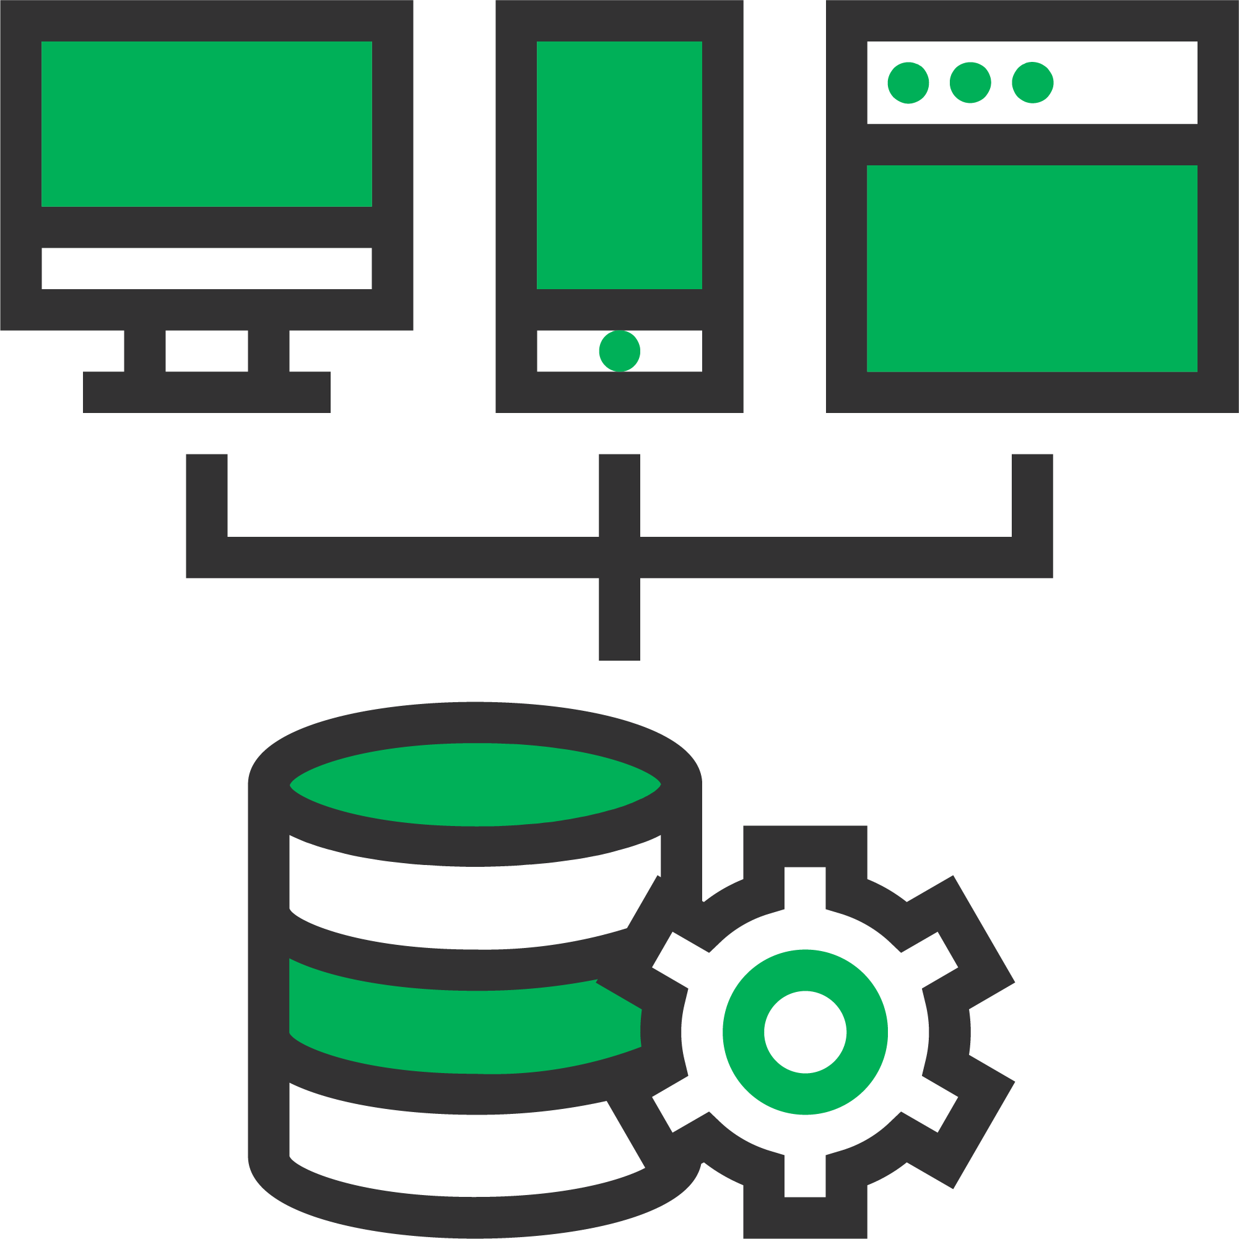
Terms: Stacks, Frameworks, & Languages
A server-side scripting language is interpreted by a web server to perform logical and algorithmic back-end operations.
Examples: PHP, Python, NodeJS, Ruby, Perl.
These languages can be used to develop dynamic web pages.
Common use-case: Facilitate communication between a web application and a database.

Slide 214
Terms: Stacks, Frameworks, & Languages
Other use-cases: login/logout operations, session management, and processing queries.
Client-side languages do not communicate directly with the web server.
Client-side languages execute code at the client level (ie. Web browser).
Client-side languages are referred to as front-end languages.
They control what the user sees through their web browser.
Examples: Text elements, images, video, UI components.

Slide 215
Terms: Stacks, Frameworks, & Languages
Two common client-side languages: HTML & CSS.
Also referred to as “markup” languages.
Both HTML and CSS define the structure on a web page.
No interpretation of logic or algorithm.
JavaScript is a true client-side scripting language.
JS is able to relay client-side processes algorithmically to dictate web page behavior.

Slide 216
INSTALLING LAMP STACK ON UBUNTU

Slide 217
INSTALLING LAMP STACK
USING LINODE MARKETPLACE

Slide 218
TESTING PHP ON APACHE

Slide 219
TEST DATABASE CONNECTION
FROM PHP [P.1]

Slide 220
TEST DATABASE CONNECTION
FROM PHP [P.2]

Slide 221
REMOTE ADMINISTRATION
USING LINODE GLISH

Slide 222
REMOTE ADMINISTRATION
USING X2GO

Slide 223
SERVER SECURITY

Slide 224
Server Security
Security is one of the most important aspects of the development lifecycle.
Server security is a vast and complex subject.
We will explore: hosted firewalls, network firewalls, network monitoring, + more.
The concepts we explore are universally applicable to virtual servers.

Slide 225
Server Security
An instance that is configured as a web server will allow incoming connections from outside systems to deliver web content over specific ports.
Server ports identify incoming and outgoing network traffic.
Example: port 80 is used for HTTP traffic over the web.
Port 25 is used for email transfer.
Port 443 is used for HTTPS or encrypted web traffic.

Slide 226
Server Security
Index File
Client
(Web Browser)
HTTP Request
(index.php)
Server
Host for website
Example: google.com
Finds index.php
In root directory
Web
Server (Apache/NGINX)
Response (html file)
Processes
Returns HTML file
as output for
Index.php
PHP
Software

Slide 227
Server Security
Most connections are likely from non-malicious internet users.
Sometimes an attacker may try to exploit weaknesses in your server configuration.
There are several reasons why a server might be exploited.

Slide 228
Security
Distributed Denial-of-Service (DDoS) attack (HTTP Flood)
Attacker attempts to overwhelm a targeted server with HTTP requests.
Each time an HTTP request is made, the server must respond.
A server that cannot handle the volume of incoming requests may crash.
Subsequent HTTP requests from that point will fail.
The server will become unreachable.

Slide 229
Server Security
Distributed Denial-of-Service (DDoS) attack (HTTP Flood)
DDoS attacks are normally done through botnets.
Botnets are a network of devices infected with malware.
Malware is capable of flooding a target machine with HTTP requests.
Firewalls can help defend against DDoS attacks.

Slide 230
Server Security
Bot
Bot
Server
Client
Bot

Slide 231
Server Security
Directory Traversal
This exploit targets poorly configured servers.
Web files are served directly from the web root directory.
Users connecting via HTTP requests should not be able to traverse beyond web root folder.
An attacker could gain access to critical system and configuration files.

Slide 232
Server Security
Normal File/Web Directory
Attacker sends
Modified path to file/directory
Attacker
Server
X
Server includes the path requested, instead of normal one
Server returns file/directory requested
Private Directory
Private File
Website
System

Slide 233
Server Security
Brute Force & Dictionary Attacks
Attacker attempts to gain entry to restricted access to server.
Typically used to access the server’s root account or accounts with root privileges.
Attacks are carried out using malware.
Automatically submit numerous login attempts using automatically generated password/username combinations based on dictionary words.

Slide 234



Server Security
Repeat Login Attempts
Access to Server
Attacker
Words List

Slide 235
INTRODUCTION TO FIREWALLS

Slide 236
Introduction to Firewalls
One of the most effective ways to safeguard a server against different types of attacks.
Firewalls act as a software/hardware layer that filters connections and data packets attempting to enter the network.
Firewalls scan incoming data packets for malicious code or identifying information, such as IP address.
Packets are compared against a list of established threats.
If a match is found, the data packet is flagged and prevented from network entry.

Slide 237
Introduction to Firewalls
HTTP requests
Are allowed
Only authenticated admins allowed SSH Access
File system resources
Firewall
SSH
PHP
Apache
Internet
HTTP
Application
Database (MariaDB)
Other requests
Other traffic is blocked.

Slide 238
Introduction to Firewalls
The concept of a firewall is simple.
Configuring a firewall can be complex depending on the objective.
If configured incorrectly, a firewall can block legitimate traffic.
Firewall setup and configuration are important skills to have.
The two main types of firewalls are Network Firewalls & Hosted Firewalls.

Slide 239
LINODE NETWORK FIREWALLS

Slide 240
Linode Network Firewalls
One of the simplest and most effective ways to safeguard a server.
Allows direct control over network traffic based on custom rules.
Configured at the network level.
Instances are hosted in a remote data center and managed by a third party.
Network firewalls can be configured through the cloud providers web console or API.

Slide 241
Linode Network Firewalls
If a network firewall is not an option, opt for a hosted firewall.
Hosted firewalls are just as effective, but harder to setup.
Fox maximum security use a network firewall and hosted firewall.

Slide 242
SECURING SSH WITH A NETWORK FIREWALL

Slide 243
Securing SSH with a Network Firewall
In the last lesson we created a network firewall to block incoming HTTP requests.
In this lesson we will improve security by changing the default SSH port from 22 to a custom port.
This makes it difficult for attackers to SSH to the server, since the port is not easily identifiable.
We will also restrict SSH access to specified IP addresses.

Slide 244
STRICT NETWORK
FIREWALL POLICY

Slide 245
HOSTED SOFTWARE
FIREWALLS (UFW)

Slide 246
Hosted Software Firewalls (UFW)
In this lesson we will demonstrate how to create hosted firewalls.
A hosted firewall is installed on a web server through software applications.
Network firewalls have first priority over hosted firewalls.
Traffic blocked at the network level will not traverse to the hosted firewall.
Network and hosted firewalls are often used together.

Slide 247
Hosted Software Firewalls (UFW)
Legitimate Traffic
LAN
Malicious Traffic

Slide 248
Hosted Software Firewalls (UFW)
UFW (Uncomplicated Firewall) is one of the most popular software firewalls for Ubuntu.
UFW comes pre-installed on Ubuntu.
UFW is disabled by default, so it must be enabled prior to use.
Designed to offer a simplified approach to configuring a custom firewall.
Easier than traditional methods like iptables and nftables.

Slide 249
Hosted Software Firewalls (UFW)
Iptables and nftables allow administrators to configure firewalls that filter IP packets.
Filters are organized in the form of tables that contain rule chains.
UFW is easier to configure than working with iptables and nftables.
UFW is user friendly and intuitive.

Slide 250
INTRODUCTION TO SCALING

Slide 251
Introduction to Scaling
Scaling refers to increasing resources (CPU, RAM, Storage, Network) to keep up with changes in application load.
As application load increases, resource needs grow.
Resources can be scaled vertically (scaling-up/down) or horizontally (scaling in/out).
Vertical scaling refers to increasing the capacity of a single instance by upgrading its hardware configuration.

Slide 252

Introduction to Scaling

Slide 253
Introduction to Scaling
A device or instance connected to a network is referred to as a “node”.
One instance = a single node.
IBM States: “a node is a connection point inside a network that can receive, send, create, or store data”.
Multiple instances on a network = “instance cluster”.
Horizontal scaling = adding nodes to distribute application load.
Multiple instances are normally connected to a load balancer.

Slide 254


Introduction to Scaling
Internet

Slide 255
LINODE VERTICAL SCALING

Slide 256
LINODE HORIZONTAL SCALING

Slide 257
INSTANCE IP SWAPS

Slide 258
INTRODUCTION TO IMAGES & BACKUPS

Slide 259
Intro to Images and Backups
Configuring instances can take time and effort.
Building applications on remote servers takes even more time and resource.
Applications and cloud architecture can grow in complexity over time.
Creating backups of disks is very important.
Especially if most development is done directly on the remote instance.

Slide 260
Intro to Images and Backups
Instance backups can be achieved with disk images.
An image is a point-in-time snapshot of an instances primary storage disks.
Three ways a disk image can be generated:
Manually through the instance manager.
Manually through the Linode backup service
Automatically through the Linode backup service.

Slide 261
Intro to Images and Backups
Manually creating disk images through the instance manager is cheaper but has limitations.
Max size limit for custom images is 6GB.
This is an issue if your primary disk utilization exceeds 6GB.
If the limit is exceeded, image creation will fail.
The maximum allowable images within a Linode account is 25.

Slide 262
Intro to Images and Backups
Linode’s backup service does not have these restrictions.
Benefits of the Backup Service:
Fully managed. No need to worry about manually creating images at various intervals.
The service helps bypass image size restrictions.
Image creation can be scheduled using customized settings.
Backups are stored in the same data center as the image and on separate dedicated hardware.
New instances can easily be deployed from saved images within the backups manager.

Slide 263
CREATING A CUSTOM IMAGE (LINODE IMAGES MANAGER)

Slide 264
LINODE BACKUP SERVICE

Slide 265
LINODE ACCOUNT CLEAN UP

Slide 266
CLOUD COMPUTING SEGMENT OVERVIEW

